Slide 1
Capstone Project for DS & AI Course
STELLAR OBJECT CLASSIFICATION

Slide 2
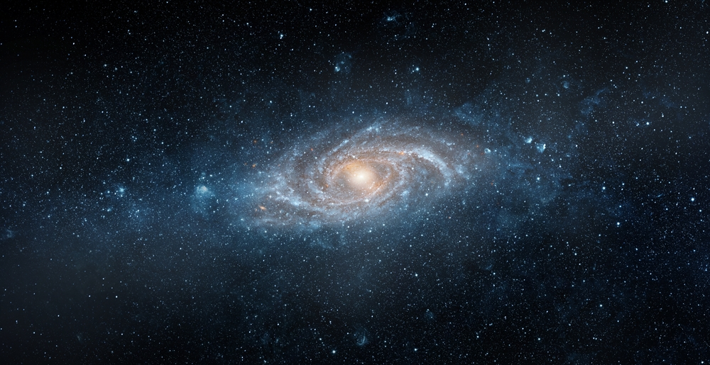
STELLAR OBJECT CLASSIFICATION
A Machie Learning Approach to Deep Space Research Data
Presented by: RAJA MAJHI

Slide 3
Agenda
What We Will Cover :
Project Introduction, Overviews & Objectives
Data Exploration
Exploratory Data Analysis (EDA) & Insights
Data Preprocessing
Machine Learning Model Approach
Model Performance & Comparative Analysis
Conclusion

Slide 4
Introduction

Slide 5
Introduction: Stellar Object Classification
Project Overview:
This project aims to develop machine learning models to classify celestial objects into stars, galaxies, and quasars. This project aims to facilitate efficient automated classification, insights into distinguishing features, and optimized data processing for large-scale surveys through the predictive models, data visualizations, and a comparative analysis of various algorithms.
Project Benefits:
Automated Classification: The models will help efficiently categorize large numbers of celestial objects from survey data.
Research Insights: Understanding the key features that distinguish different celestial objects can guide future astronomical research.
Data Processing Optimization: Identifying the most effective classification algorithms can improve data processing pipelines for large-scale astronomical surveys.

Slide 6
Project Objectives:
The Challenge: Modern astronomical surveys like SDSS generate petabytes of data containing millions of celestial objects. Manually classifying these objects (star, galaxy, quasar) is infeasible.
Our Solution: To develop a robust, automated Machine Learning algorithm to accurately classify these objects, enabling faster and more efficient astronomical research.
Key Objectives:
Automate Classification: Build ML models to categorize objects from large-scale survey data efficiently.
Gain Research Insights: Identify the most significant features that distinguish stellar object types.
Challenges
Automated Classification
Analysis
Processing

Slide 7
Steps included in the process:
Data collecting
EDA & Visualization
Preprocessing
Model initialize
Hyper-parameter Tuning
Feature Importance & Validate
Recommendation & Reporting
Data Collect and Basic Inspection.
Exploratory Data Analysis & Visualization.
Preprocessing.
Initialize Seven Machine Learning Model.
Hyperparameter Tuning.
Feature Importance & Validation.
Recommendation.
Reporting.

Slide 8
Dataset Overview:
Dataset Collection:
star_classification.csv
Dataset Loading:
The dataset is loaded from 'star_classification.csv'
Initial Exploration:
Basic exploration is done using .shape and .head() to understand the dataset structure.

Slide 9
Dataset Overview:
Key Features:
obj_ID: Object Identifier, the unique value that identifies the object.
alpha & delta: Right Ascension angle (at J2000 epoch) Declination angle (at J2000 epoch).
u, g, r, i & z: Color parameters (Photometric filters: main features).
run_ID & rerun_ID: Used to identify specific scan and image proce0ssing.
class: Star, galaxy and Quasar(main target column).
redshift: redshift value based on the increase in wavelength.

Slide 10
Exploratory Data Analysis (EDA) - Key Visualizations
Insight 1: Class Distribution The dataset is moderately imbalanced, with galaxies being the most prevalent class. This was considered during model evaluation.
Insight 2: Color Indices Distribution The engineered color indices (u_g, g_r, etc.) show distinct distributions, confirming their utility in separating the classes.
Conclusion from EDA: The features, especially the redshift and color indices, show strong predictive potential for distinguishing the three classes.

Slide 11
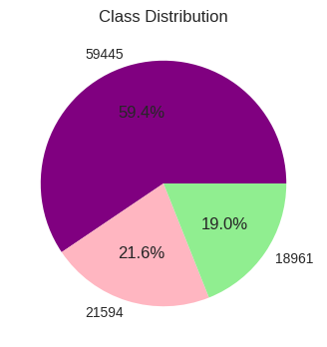
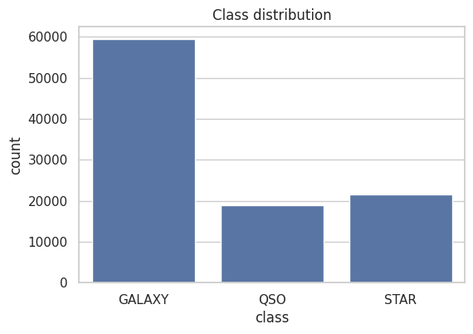
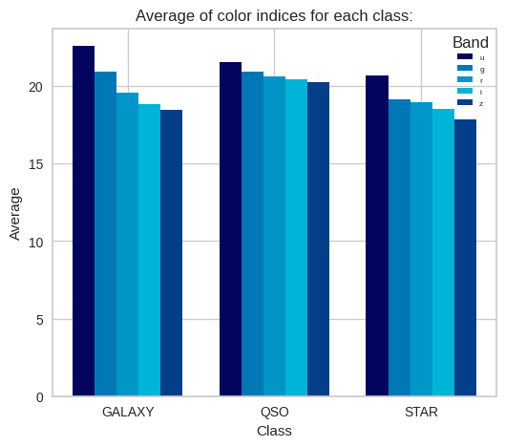
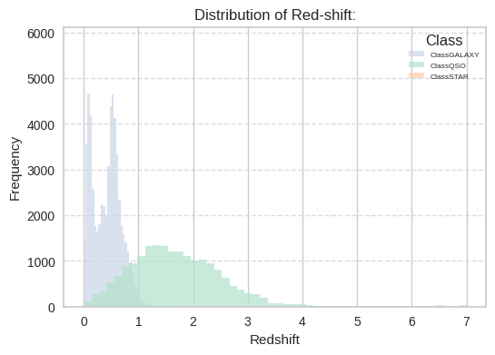
Exploratory Data Analysis(EDA) & Visualization:

Slide 12
Data Preprocessing:
Data Cleaning
Feature Engineering
Labeling
Train-Test-Split
Scaling
Data Cleaning
Drop irrelevant columns.
Feature Engineering
Selecting the features and target.
Labeling the data
Encoding target variables (Stars, Galaxies, Quasarrs as 0/1/2).
Train-Test-Split
Spliting the features into 80% training and 20% testing .
Scaling Features
Use Min-Max to scaling the color indicies(u, g, r, i, z) using StandardScaler.

Slide 13
Machine Learning Modeling Approach
Algorithms Evaluated: We implemented and compared a diverse set of 7 powerful classification algorithms to ensure a robust analysis:
Decision Tree (DT) - Baseline model
Random Forest (RF) - Ensemble of trees, robust to overfitting
K-Nearest Neighbors (KNN) - Instance-based learning
Support Vector Machine (SVM) - Finds optimal separating hyperplane
Gradient Boosting (GB) - Builds trees sequentially to correct errors
AdaBoost - Adaptive boosting algorithm
XGBoost - Optimized gradient boosting designed for speed and performance

Slide 14
Evaluation of Classification Algorithms
Decision Tree
Concept: A simple, hierarchical model that makes predictions by learning a series of if-else questions based on the data features. It's a single, complex flowchart. A flowchart of simple yes/no based in the dataset and follows the answer down the branches until it achieved the final decision. Suitable for binary classification.
Random Forest
Concept:Instead of one complex flowchart, it creates hundreds of simpler, slightly different flowcharts. Just like a whole team of flowcharts voting together. This is Ensemble Learning Method(bagging algorithm).
K-Nearest Neighbors (K-NN)
Concept:It's a simple, intuitive method that finds the most similar known objects and copies their label.

Slide 15
Evaluation of Classification Algorithms
Support Vector Machine (SVM).
Concept: It's very effective for complex classifications where the groups aren't easily separated by simple lines. It's a boundary-drawing expert that aims for the widest possible margin.
Gradient Boosting
Concept: It's a sequence of flowcharts where each one learns from the last one's mistakes. It repeats this process many times, with each new model trying to fix the mistakes of the previous ones.
AdaBoost.
Concept: It's another powerful boosting technique that is particularly good at making a strong model out of many weak ones. It's like Gradient Boosting but specifically focuses more weight on previous errors.

Slide 16
Evaluation of Classification Algorithms
XGBoost.
Concept: Highly optimized and uses advanced math to make the "learn from your mistakes" process extremely fast and efficient. It's the super-charged, optimized version of Gradient Boosting.

Slide 17
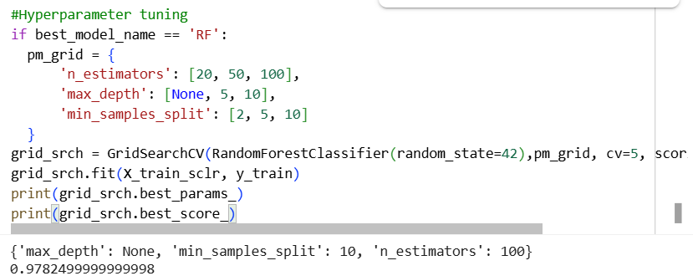
Hyperparameter Tuning
Assuming the model as a guitar.
A guitar has knobs for tuning.
If don’t adjust them properly, the guitar might sound bad.
But if tune them correctly, the guitar .
Affect Bias vs. Variance
Small depth → high bias (underfitting).
Large depth → high variance (overfitting).
Tuning balances both.
Affect Accuracy
Wrong learning rate - poor convergence.
Wrong n_neighbors in KNN - noisy predictions.
Affect Efficiency
Too many trees in RandomForest = slow training.
Too few = unstable predictions.

Slide 18
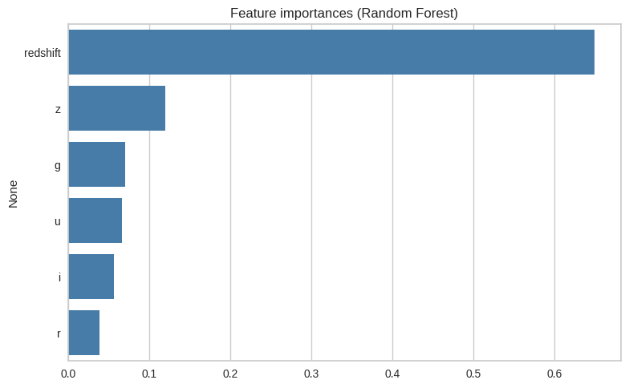
Feature Importance
Feature importance helps us know which features matter most for making accurate predictions, so we don’t treat all data equally.
Improves Interpretability.
Helps Feature Selection.
Domain Insights.
Model Comparison.
Top Features: g, r, z filters, and Redshift.
Interpretation: These features are key for distinguishing stars, galaxies and quasars.

Slide 19
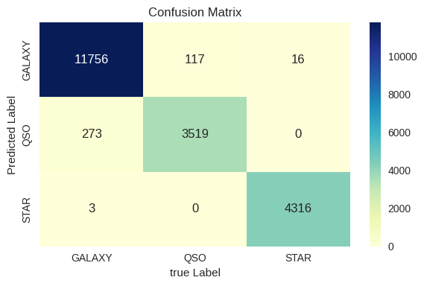
Confusion Matrix
Think of it as a “truth vs guess” table. If the model saw 100 stars, how many did it actually call “star”? Mistakes are when it thought a star was a galaxy or QSO. In your case, most predictions were correct, meaning the model rarely got confused.
It shows how many objects of each class (Galaxy, Star, QSO) were correctly or wrongly predicted by the model. The diagonal cells = correct predictions, off-diagonal = mistakes. High values on the diagonal mean strong model performance.

Slide 20
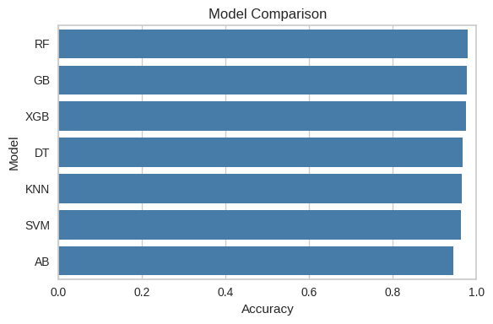
Model Comparison
Imagine several doctors diagnosing the same patient. This chart tells you which doctor is the most accurate. In your case, “Random Forest doctor” is usually right, while “AdaBoost doctor” makes more mistakes.
A bar/line chart showing accuracy (or f1-score) of different models like Random Forest, XGBoost, SVM, etc. Here, Random Forest, Gradient Boosting, and XGBoost scored the best (~98%), while AdaBoost and SVM did slightly worse.

Slide 21
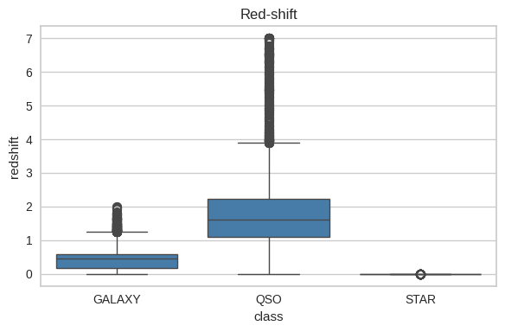
Redshift
Think of redshift as how “stretched” the light is from far-away objects. Nearby stars have little stretching, galaxies have moderate, and QSOs (quasars) are super far away, so their light is stretched a lot. The graph helps separate them.
Redshift measures how far away and fast a cosmic object is moving away. The graph shows redshift distribution for Galaxies, Stars, and QSOs. QSOs usually have higher redshift, meaning they are farther in the universe.

Slide 22
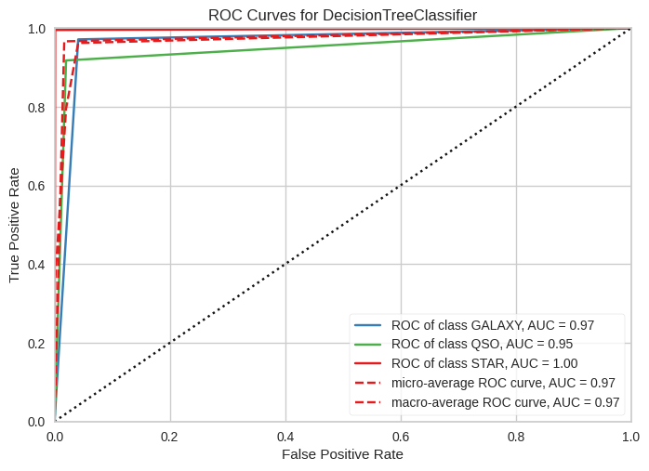
ROC-AUC Curve
This is like testing how well a dog can sniff out a treat without being tricked. A perfect sniffer scores 100%. Your model’s ROC curves are very close to perfect, so it almost never gets tricked.
The ROC curve plots true positive rate vs false positive rate. The closer the curve is to the top-left corner, the better. AUC near 1.0 means the model is very strong at distinguishing between classes.

Slide 23
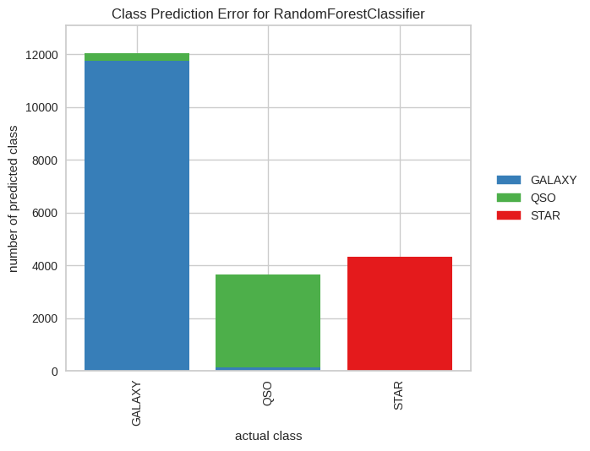
ClassPredictionError
A visualization of where the model makes mistakes by class. For example, it may mislabel some QSOs as Galaxies because their features overlap.
Helps identify weak spots in classification.

Slide 24
Summary
The models classify space objects (Galaxies, Stars, QSOs) with very high accuracy, especially with Random Forest and XGBoost. The confusion matrix confirms strong prediction ability. The redshift graph separates objects by distance, with QSOs being the farthest. The ROC-AUC curve shows near-perfect classification, and the class prediction error graph reveals QSOs are hardest to classify.
Notes:
Trainer Must Explain this project to Students
Trainer Can share the link with Students

Slide 25
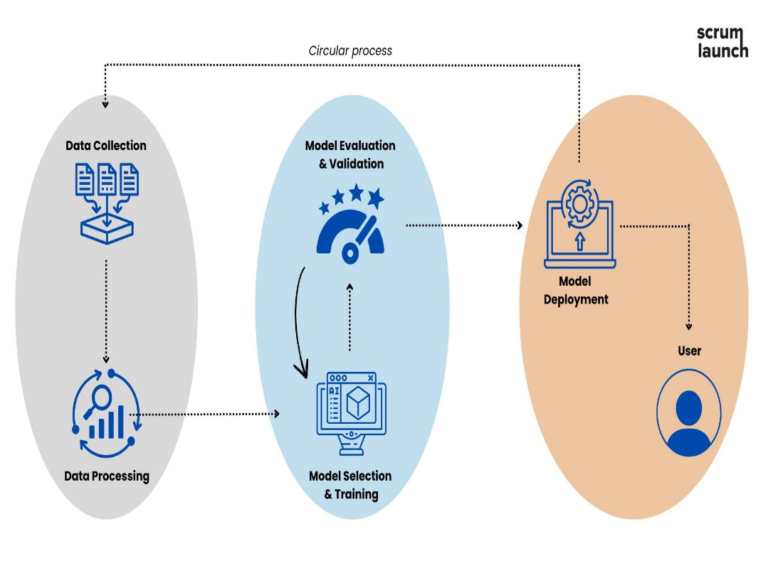
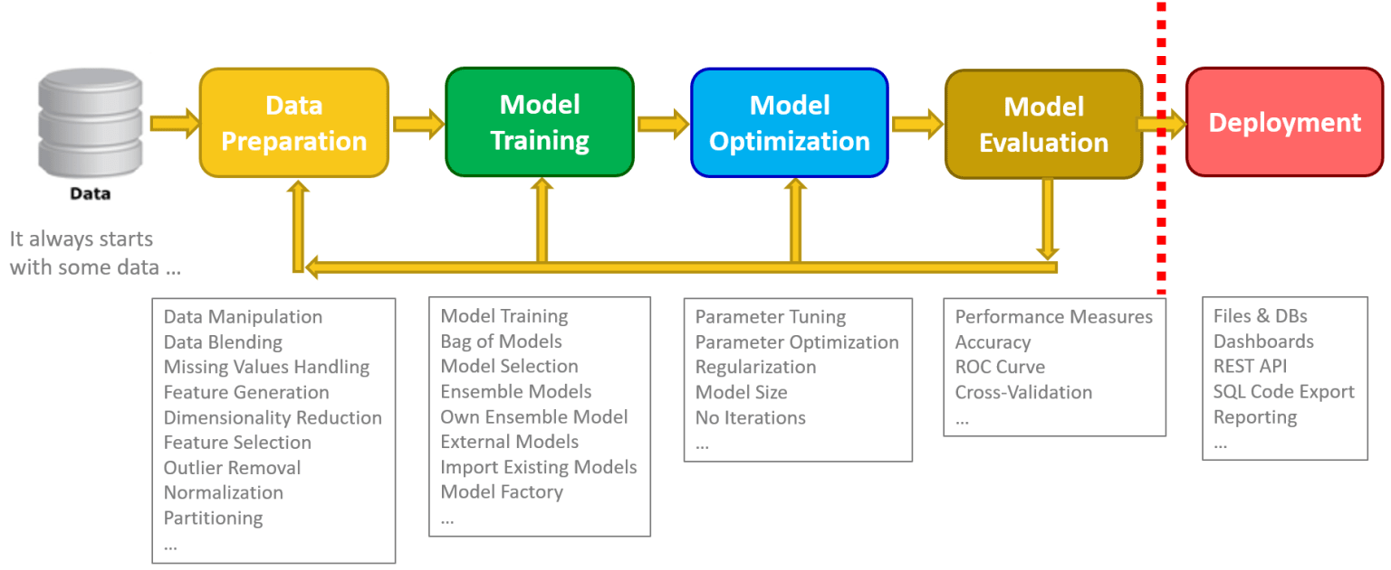
Model Deployment
Model deployment involves the process of making trained machine learning models development and integration in real world environment.

Slide 26
Business Recommendation
Adopt the Best-Performing Model
The Random Forest and XGBoost models consistently achieved the highest accuracy (≈98%).
Recommendation: Use one of these as the primary classification engine for astronomical surveys and automated object detection pipelines.
Support Research & Funding Decisions
Accurate classification helps allocate expensive telescope time more efficiently (e.g., follow-up on QSOs since they’re rarer and more valuable for cosmology).
Recommendation: Direct funding and research focus toward building a scalable system that integrates these models into observatories.
Future Improvements
While stars and galaxies are easy to classify, QSOs are slightly trickier.
Recommendation: Invest in additional training data and feature engineering for QSOs to reduce misclassification.

Slide 29
Thank You!

